Slide 1
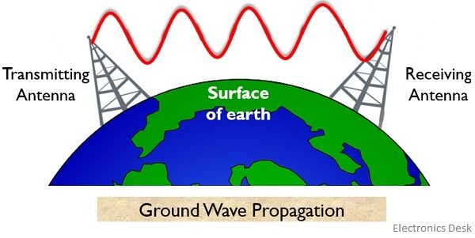

Slide 2
What is Ground Wave Propagation?
The name itself is indicating that in the ground wave propagation, the electromagnetic waves are propagated from an end to the other through the surface of the ground by gliding over it.
We know the propagation of electromagnetic waves comes under wireless communication in which the space between transmitting and receiving antenna is utilized for the propagation of the signal. So, for this, the two ends must necessarily contain transmitting and receiving antenna in order to allow signal propagation.
The electromagnetic wave from transmitting antenna propagates and gets collected by the receiving antenna. Therefore, we can say that for the propagation of electromagnetic waves, the last element of the transmitting end must be a transmitting antenna and the first element of receiving end must be a receiving antenna. So, in the ground wave propagation, the two antennas (i.e., transmitting and receiving) placed in the ground allow propagation of the signal in the form of electromagnetic waves through the earth’s surface.

Slide 3
In the above figure, it is clearly shown that two antennas are placed on the surface of the earth. We have already discussed in the beginning that ground wave propagation allows short-distance operation. Thus the transmitting and receiving antennas must not be present at a very large distance with respect to each other.
Basically when the signal is transmitted or received to or from the antenna then the orientation of the waves depends upon the orientation of the antenna on the ground. In the ground wave propagation, the antennas are placed vertically to the ground therefore the orientation of the waves is also vertical to the ground.
The waves when emitted from the transmitting antenna, oscillates parallel to the surface of the earth. During transmission, when wave oscillates on the surface of earth then oscillations induce a wave of equal magnitude but opposite polarity on the surface.

Slide 4
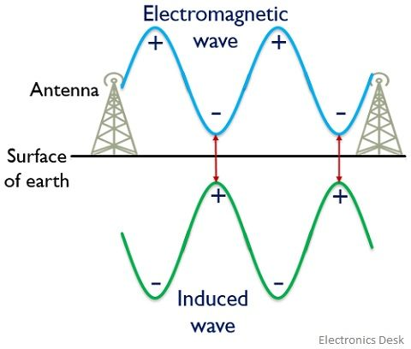
Fig: Groundwave / surface wave propagation

Slide 5
As we can see that the induced wave is opposite in phase with the actually transmitted electromagnetic wave. So, this causes neutralization of charges that resultantly cause a reduction in the magnitude of the field with distance.
Now the question arises, do all the opposite charges neutralize each other? So, the answer is No. The charges of opposite polarity that are placed closer to each other neutralize each other while the charges separated at a large distance do not get neutralized thus propagates along the surface. In this way, an attenuated signal is collected by the receiving antenna.
In other words, the same principle can be said in a way that the number of charges varies according to the intensity and location of the field and the flow of charges generates a current. When current flows through the surface of the earth it behaves as a leaky capacitor. And so while propagating, some amount of energy gets absorbed that causes the weakening of the transmitted wave. The energy absorbed by the surface of the earth leads to cause loss of power which is due to the resistance offered by the surface to the flow of charges.

Slide 6
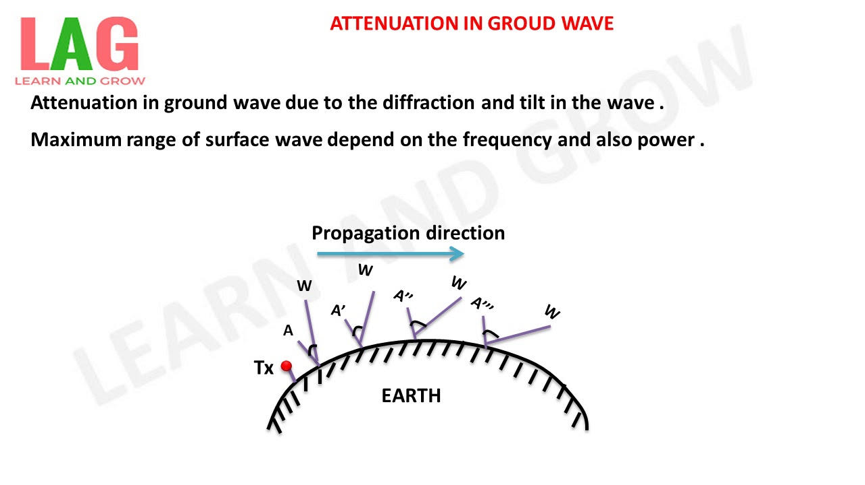
Wave tilt
Wave tilt is defined as the change of orientation of the vertically polarized ground wave at the surface of the earth. This occurs due to diffraction. Due to tilt, both horizontal and vertical components of the electric field exists and are not in phase.

Slide 7
Advantages of Ground Wave Propagation
The factor of large wavelength supports efficient bending thereby causing less attenuation.
The signal loss due to atmospheric conditions is less.
Disadvantages of Ground Wave Propagation
The distance between the transmitting and receiving end must not be very large.
The operational frequency range is limited to up to 2MHz.
Applications
Ground wave propagation finds its applications in various fields like television signal broadcasting, target detection for military purposes, radio signal transmission, and in all such applications that require a distance of operation in the local range.

Slide 8
Advantages of Ground wave
Following are the benefits or advantages of Ground wave:
➨As it uses lower frequencies, interference occurs due to atmospheric noise only. Moreover absorption of EM waves at lower frequencies are less. Hence it can cover longer distances. However the pathloss increases as distance from transmitter increases. Hence distance between Tx and Rx should be optimal.
➨They are vertically polarized in order to prevent short circuit of electric field (E) component.

Slide 9
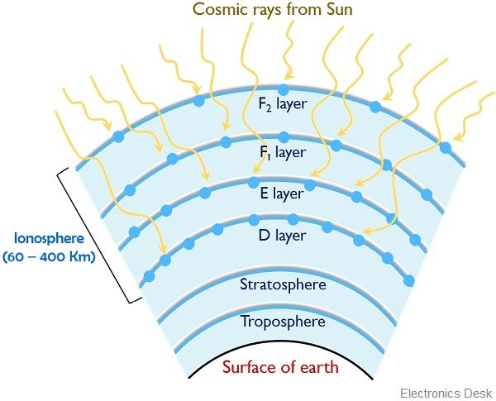

Slide 10
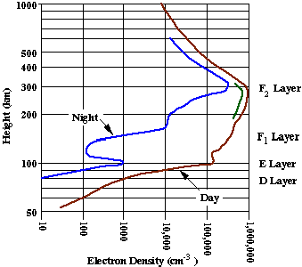

Slide 11
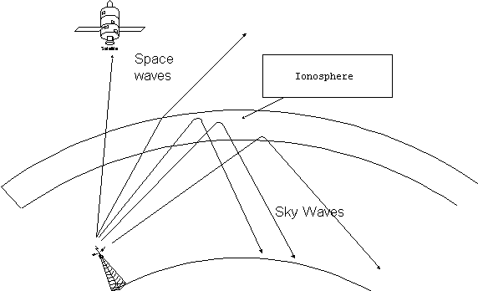

Slide 12
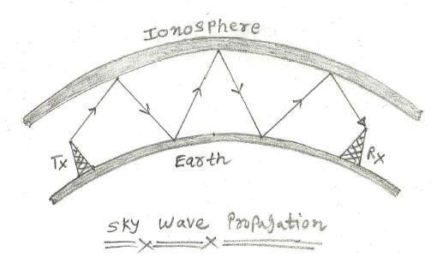
The signals are reflected from ionized layer of the atmosphere known as Ionosphere. Here signals can travel number of hops, back and forth.

Slide 13
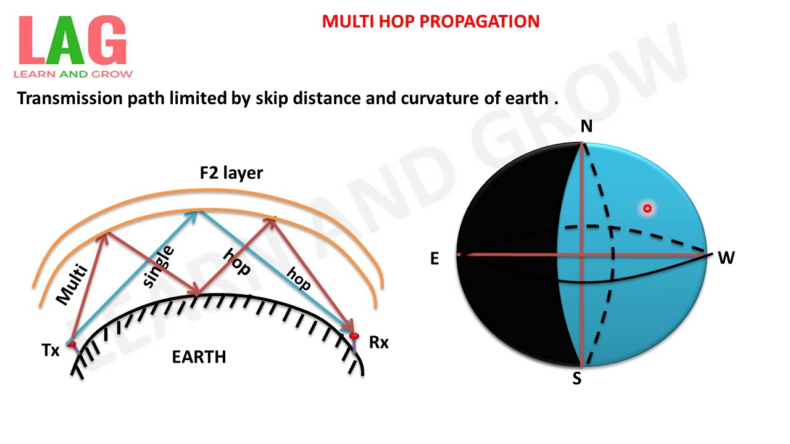

Slide 14
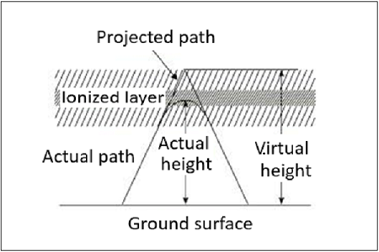

Slide 15
Advantages of Sky wave
Following are the benefits or advantages of Sky wave:
➨As it utilizes reflective property of ionosphere available above earth at higher frequencies, it is most simple mode of propagation and provides continuous support in communications.
Disadvantages of Sky wave
Following are the disadvantages of Sky wave:
➨Ionoshere is present near or far during night time and day time respectively. Due to this, Sky waves can travel longer or smaller distances.
➨Transmitter signal travels multiple hops before reaching the receiver. This reduces signal strength considerably if distances are larger between transmitter and receiver antennas.

Slide 16
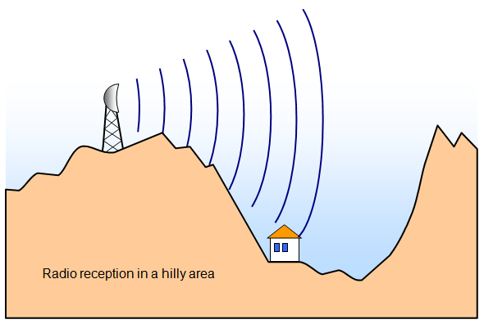

Slide 17
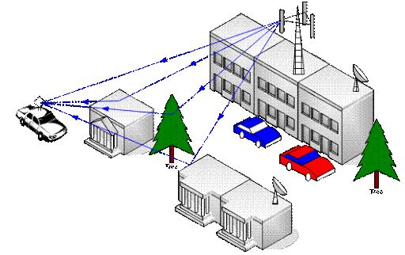

Slide 18
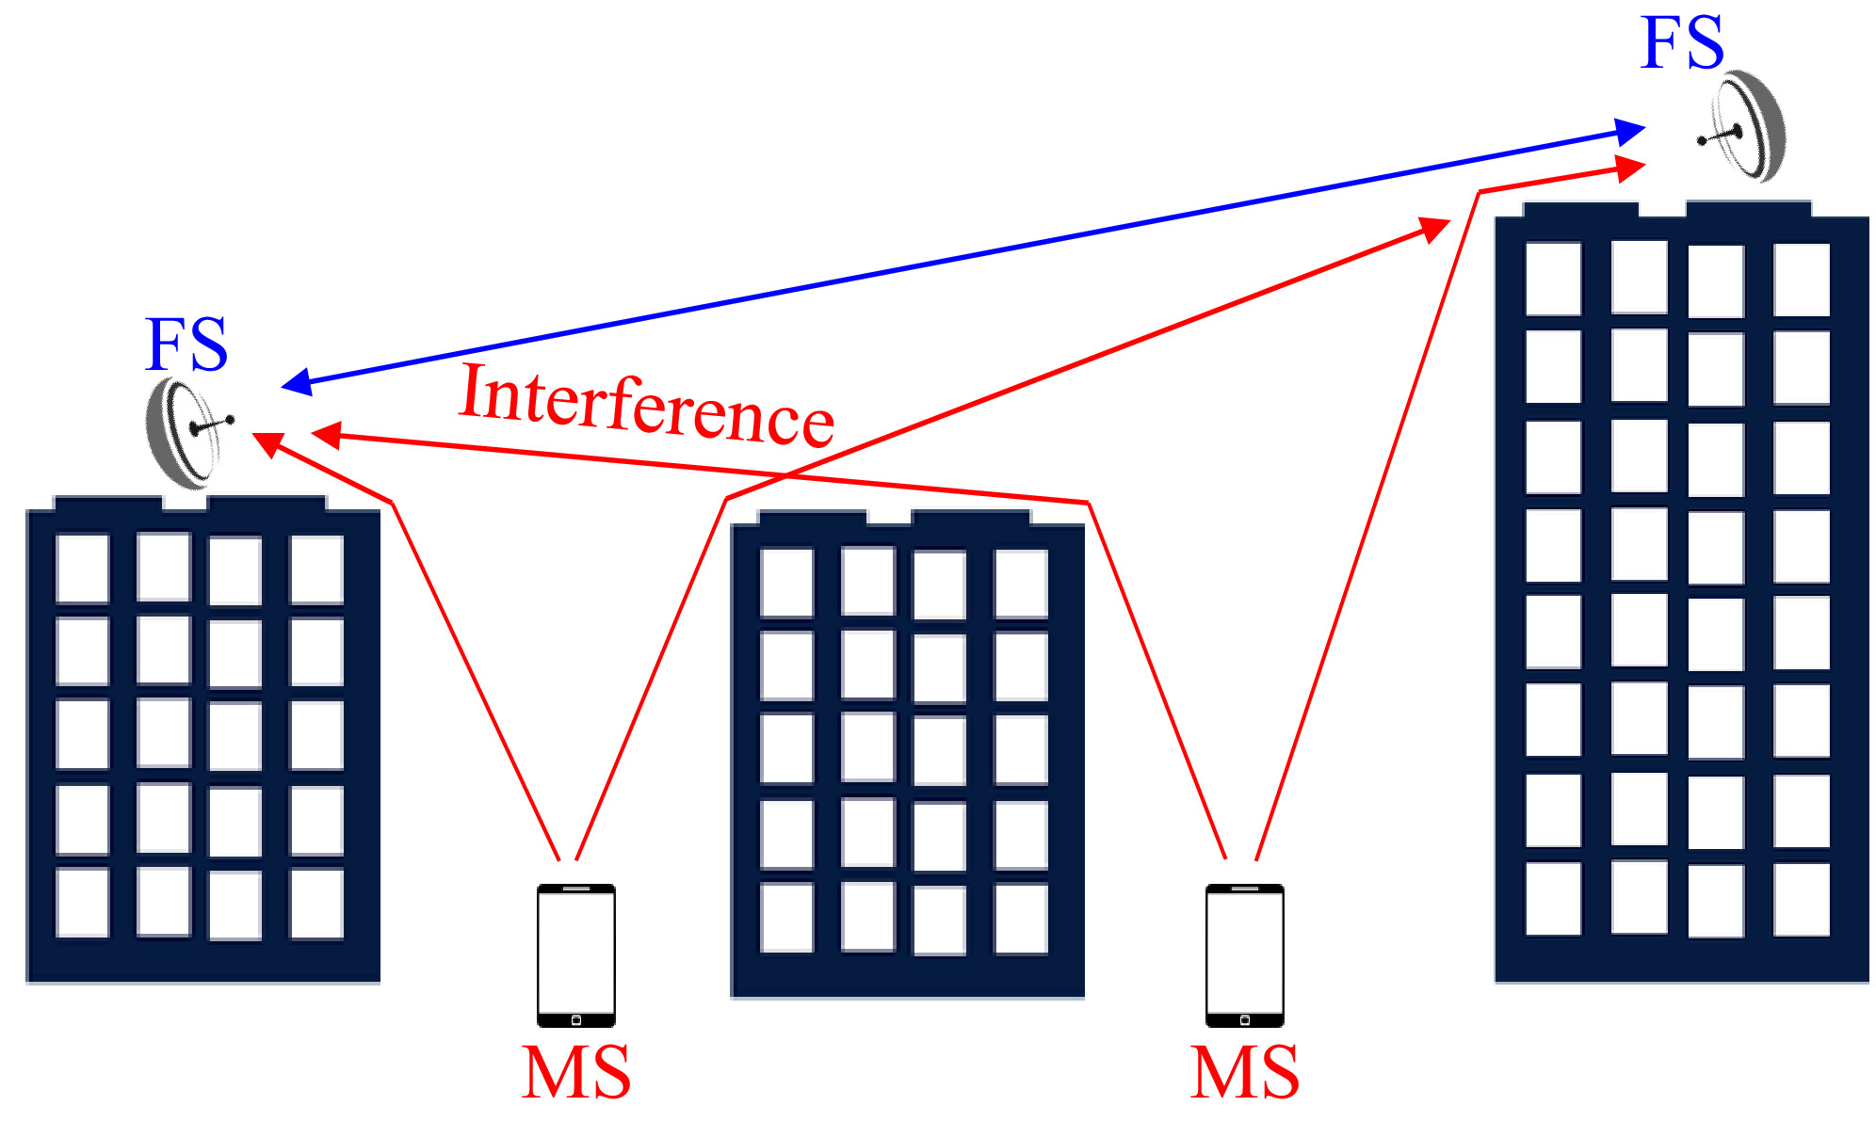

Slide 19
Space Wave Propagation
Definition: Space wave propagation is the type of radio wave propagation in which the radio waves are propagated either directly from transmitting antenna to receiving antenna or by getting reflected from the ground. Basically in space wave propagation, direct transmission of the signal is achieved by line of sight communication.
The transmission of a signal between transmitter and receiver is achieved in the tropospheric region of the atmosphere. Thus space wave propagation is sometimes referred as tropospheric wave propagation.

Slide 20
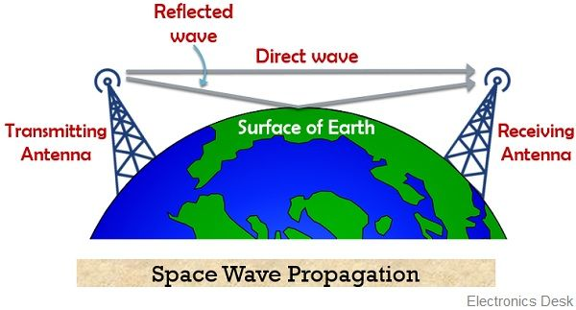

Slide 21
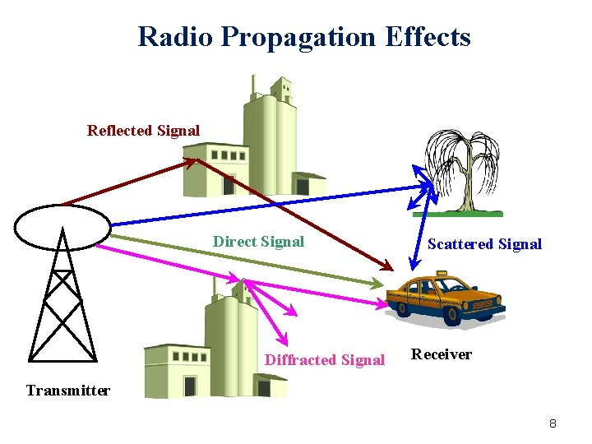

Slide 22
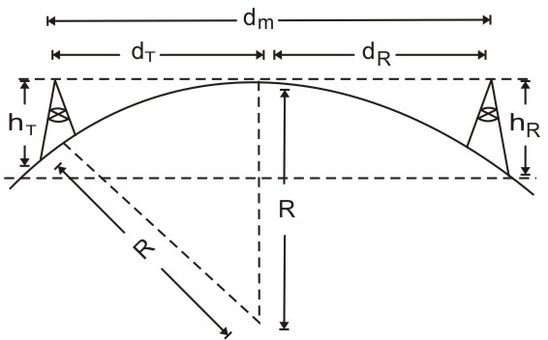

Slide 23
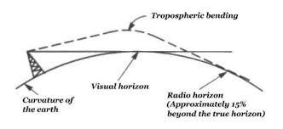

Slide 24
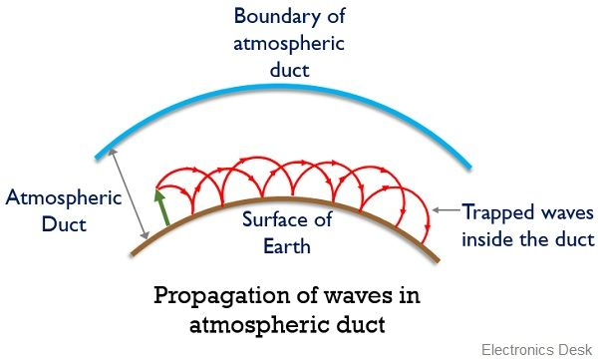

Slide 25
What is temperature inversion?
As we have already discussed that stratopause is the region present next higher to troposphere.
The temperature of this region generally remains constant. The region has a dielectric constant which is somewhat greater than 1 at the surface of the earth, as it is denser than the region of the upper atmosphere. While on moving upwards as the air density decreases to 0, the dielectric constant attains unity value.

Slide 26
What is Duct Propagation?
Duct propagation is the phenomenon of transmitting UHF and VHF signals to longer distances. We have already discussed that the presence of a layer of cool air between warm air, generates a duct that guides the high-frequency signals inside it like a waveguide.
Basically the wave propagates inside a duct by undergoing successive refractions inside it. The change in the refractive index due to warm and cool layers in the atmosphere causes duct propagation.
We have understood the unusual atmospheric conditions that cause the generation of the duct. However, for duct propagation to take place, the two necessary conditions are as follows:
The transmitting antenna must be extended up to the region of duct in the atmosphere and
The angle of incidence of radio waves should be less than the value of the critical angle.

Slide 27
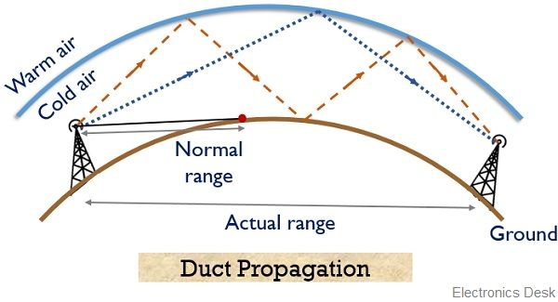

Slide 28
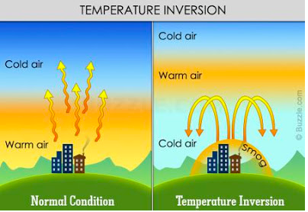
The effects of temperature inversions in the atmosphere range from mild to extreme. Inversion conditions may cause interesting weather patterns like fog or freezing rain or may result in deadly smog concentrations. The atmosphere's largest temperature inversion

Slide 29

fog

Slide 30
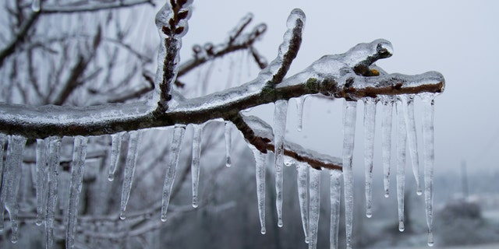
freezing rain

Slide 31
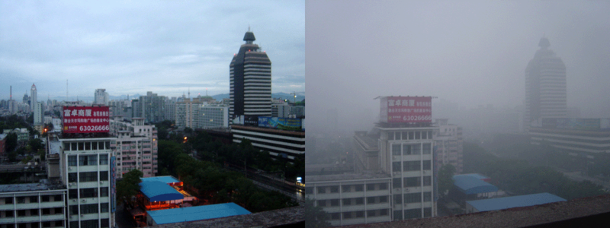
deadly smog concentrations

Slide 32
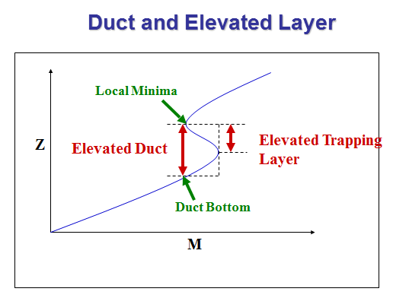

Slide 33
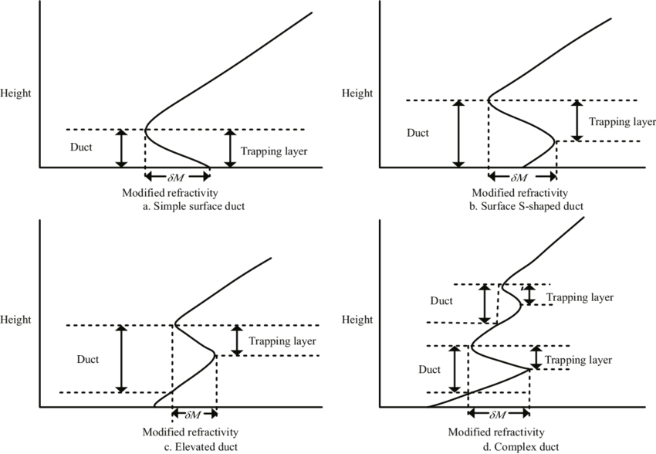

Slide 34
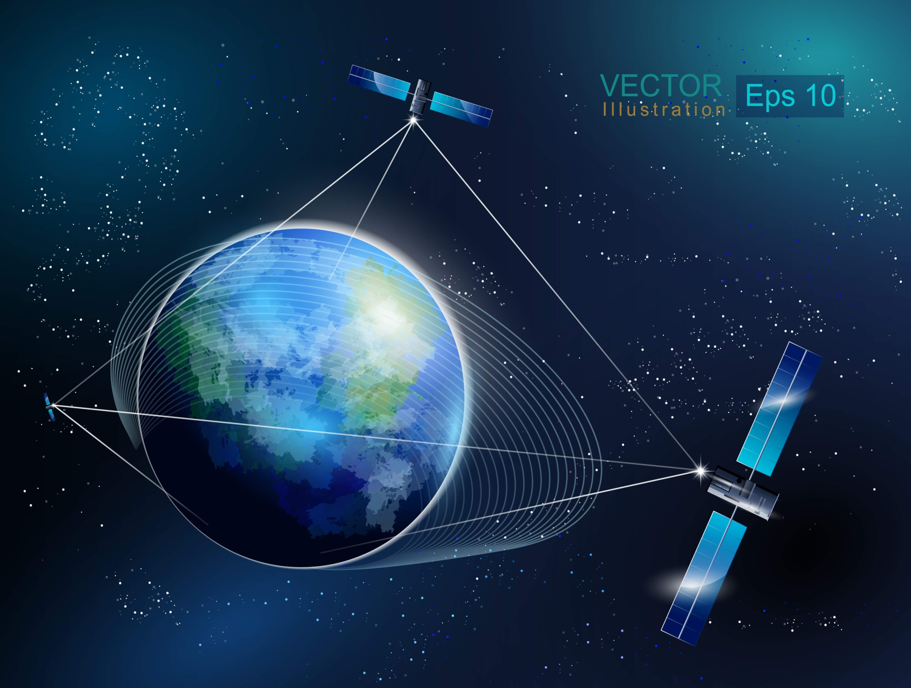

Slide 35
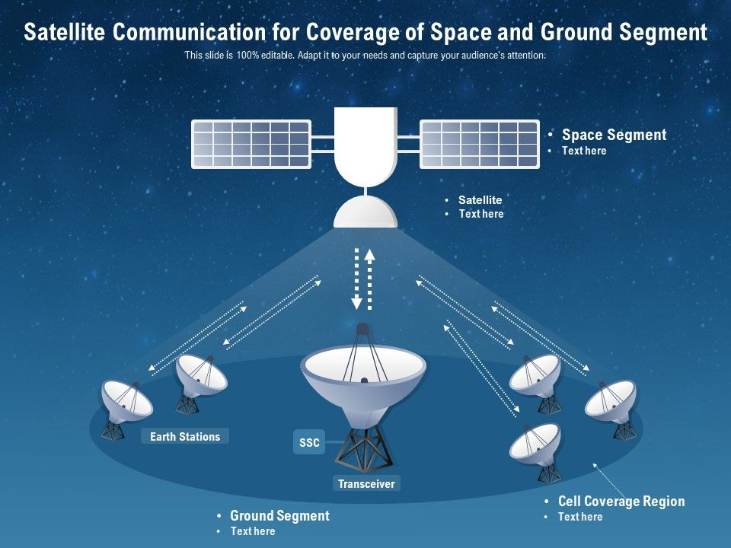

Slide 36
